Slide 1
Bivariate Analysis
Friday, 08 November 2024

Slide 2

Outline
Introduction to R
Simple bivariate analysis
Examples

Slide 3
The basics
Student t test
Chi square test
Statistical significance versus Clinical significance

Slide 4
The basics
Student t test
Chi square test
Statistical significance versus Clinical significance
P-value:
The p-value is the probability of obtaining results at least as extreme as the observed results of a statistical hypothesis test, assuming that the null hypothesis is correct

Slide 5
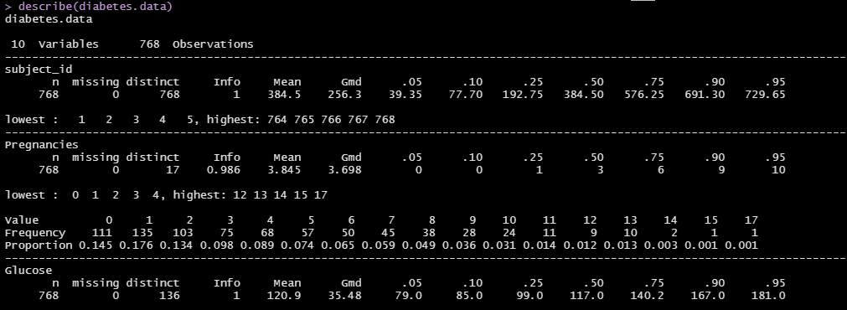
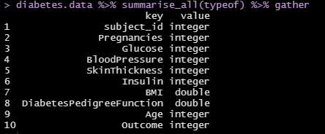
data

Slide 6
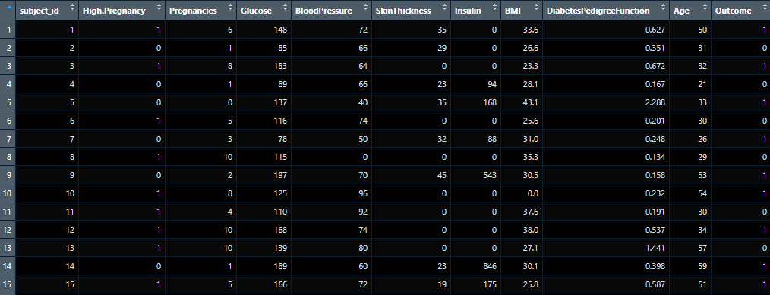
data
X1
X2
Y
Y = Outcome
X₁ = Group
X₂ = Glucose
Dependent variable:
Outcome
Independent variables:
Group
Gender

Slide 7
Table 1 – Demographic information
Table 1. Group demographics.
Variable | Group 0 | Group 1 | test statistic (df) | p-value
Age (years), mean (SD) | 27.7 (8.9) | 40.1 (11.2) | -77.207 (769.75) | <0.001
Glucose (mg/dL), mean (SD) | 116.9 (31.3) | 125.9 (32.2) | -104.39 (767.37) | <0.001

Slide 8
Student t test
 | Outcome
Group 0 | Y₀
Group 1 | Y₁
Y is the outcome or response (dependent variable)
Y is on a continuous or interval scale
Continuous scale {0: 10} include all values between 0 and 10 such that:
1.0, 1.2, 1.5, 1.7, 2.0, 3.3, … , 10.0

Slide 9
Student t test
Groups | Age (years), mean
Group 0 | 27.7
Group 1 | 40.1
Group 0 mean age = 27.7 years
Group 1 mean age = 40.1 years
P-value <0.001
Is this statistically significant?
Is this clinically significant?

Slide 10
Chi square test
 | Outcome 0 | Outcome 1
Group 0 | Y_{0,0} | Y_{0,1}
Group 1 | Y_{1,0} | Y_{1,1}
Y is the outcome or response (dependent variable)
Y is on a discrete (frequency) scale
Discrete scale {0, 1} is either 0 or 1
Example: Gender {0, 1}, where 0 = male, 1 = female

Slide 11
Chi square test
Groups | Male | Female
Group 0 | 3 | 7
Group 1 | 5 | 5
Group 1 has 3 males and 7 females
Group 2 has 5 males and 5 females
P<0.361
Is this statistically significant?
Is this clinically different?

Slide 12
Research question
Do patients in Group 1 have higher mean BMI than patients in Group 0?
Do patients in Group 1 have a higher proportion that experienced the outcome than patients in Group 0?

Slide 13
Student t test example
Do patients in Group 1 have higher mean BMI than patients in Group 0?
H0: There is no difference in average BMI between groups
HA: There is a difference in the average BMI between groups
 | BMI (kg/m^2), mean (SD)
Group 0 | 31.8 (8.4)
Group 1 | 32.3 (7.2)

Slide 14

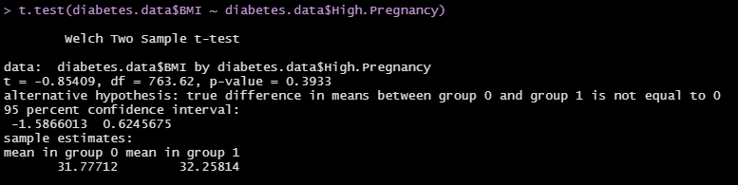
Student t test example
Type: ?t.test

Slide 15
Chi square test example
Do patients in Group 1 have a higher proportion that experienced the outcome than patients in Group 0?
H0: There is no difference in number of HD between groups
HA: There is a difference in number of HD between groups
 | High dose | Low Dose
Group 0 | 113 (26.7%) | 311 (73.3%)
Group 1 | 155 45.1%) | 189 (54.9%)

Slide 16
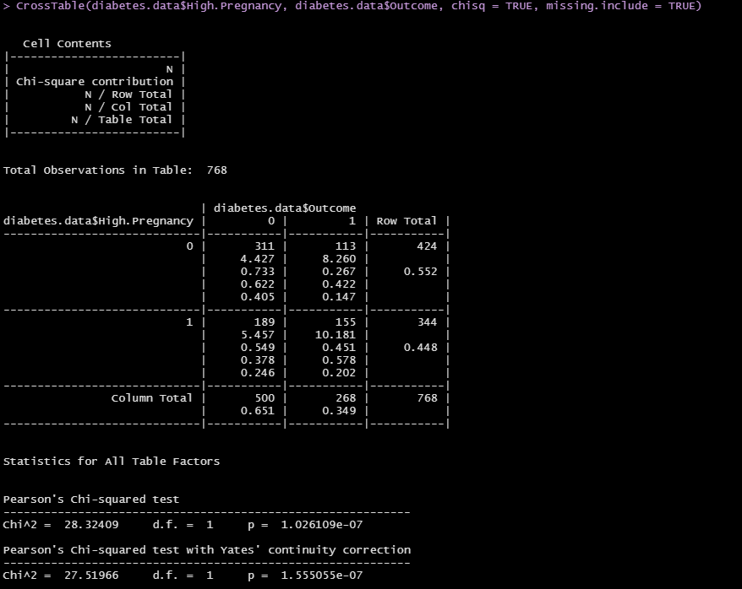
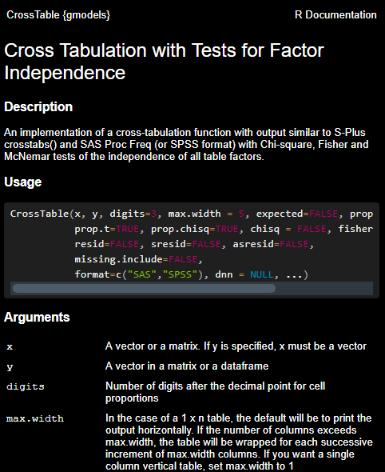
Chi square test example
Type: ?CrossTable

Slide 17
Statistical versus clinical significance
Statistical significance only tells you whether there is a mathematical difference
Clinical significance is determined by the minimal clinically important difference (MCID)
Statistical significance ≠ Clinical significance
First, need to establish statistical significance prior to claims about MCID

Slide 18

LINKS AND RESOURCES
Conducting t tests in R

Slide 19

Questions

